Slide 1
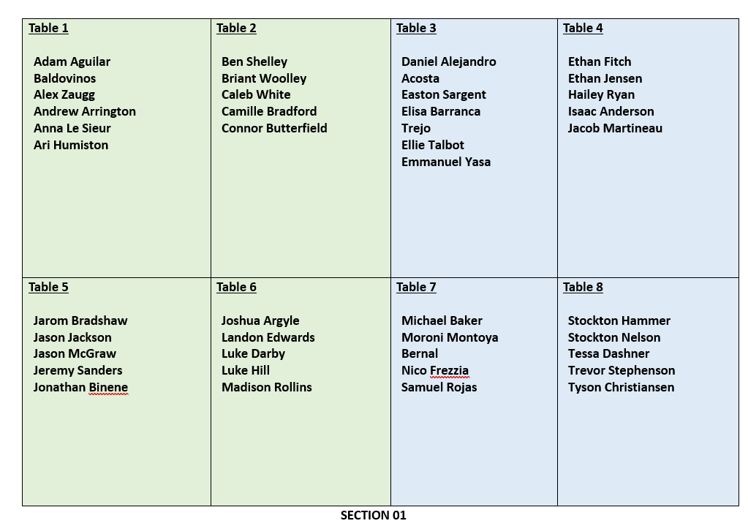

Slide 2
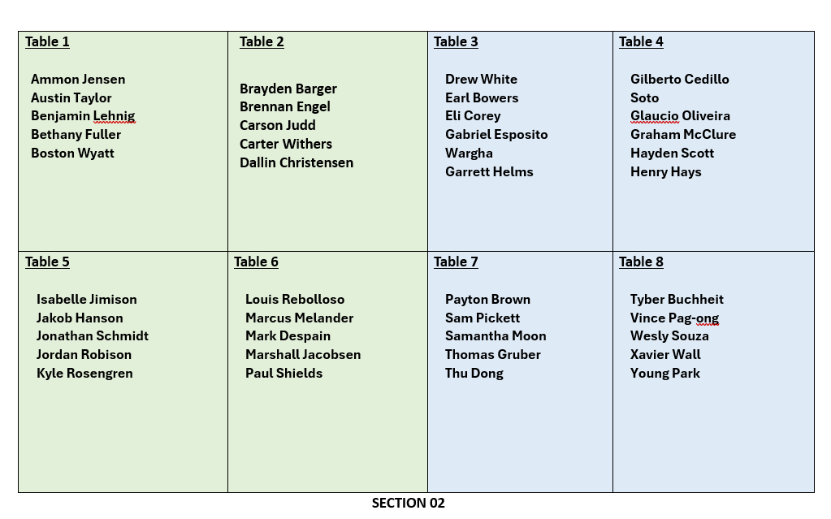

Slide 3
CSE 170 Technical Teamwork Fall 2024
Self Awareness

Slide 4
Opening Prayer

Slide 5


Spiritual thought
Life is not an endless sequence of emotional highs. “For it must needs be, that there is an opposition in all things.” And if God Himself weeps, as the scriptures affirm He does, then of course you and I will weep as well. Feeling sad is not a sign of failure. In this life, at least, joy and sorrow are inseparable companions.
Dieter F. Uchtdorf - Apr 2024 – A Higher Joy

Slide 6

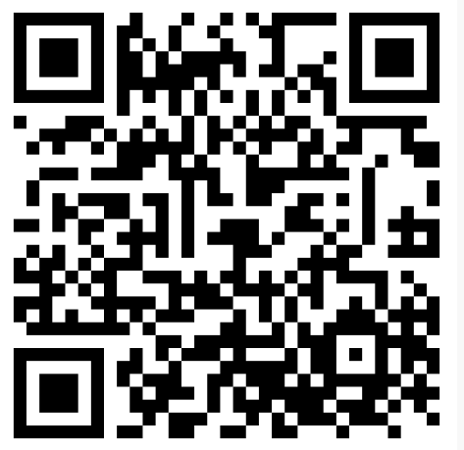

Wellness center
https://www.byui.edu/wellness-center/

Slide 7

Agenda
Self-Awareness
Understanding Self-Awareness
Assignments
Review assignments and due dates
Initial the roll
Improving Self-Awareness

Slide 8
Assignments
U02 Prepare: Articulate (Discussed in class today)
Answer 4 questions about self-awareness
Due Wed. 9/25
U02 Prove 0: Teamwork Skills
Answer a self-assessment about your teamwork skills and abilities
Due Wed. 9/25
U02 Teach: Analyze (Discussed in class Wednesday)
Answer a question about the Phillip Walker case study
Due Sat. 9/28

Slide 9

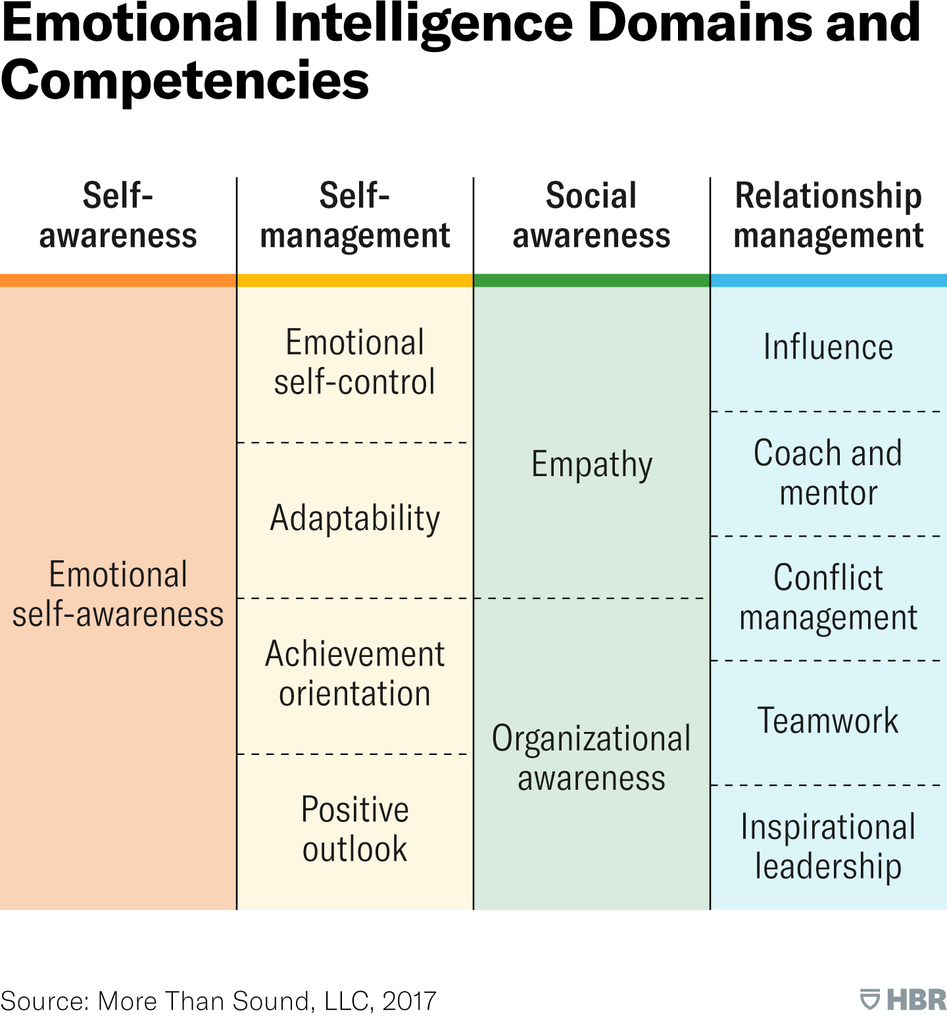

Emotional Intelligence

Slide 10
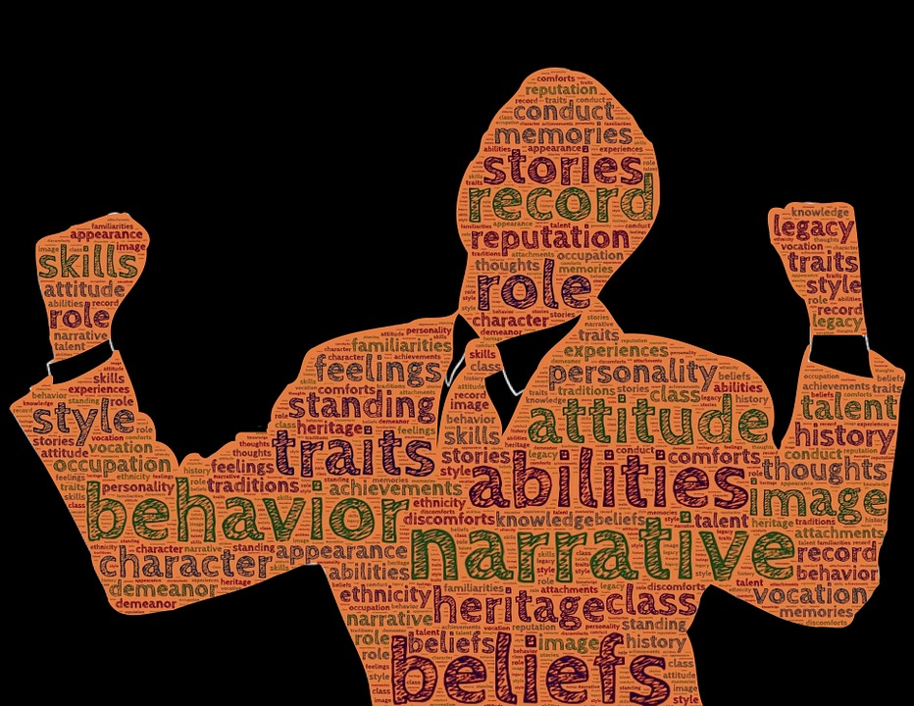
Understanding Self-Awareness

Slide 11
Self-Awareness
Tasha Eurich, a renowned expert in the field of psychology, defines self-awareness as
“The WILL and the SKILL to see ourselves clearly,
to understand who we are,
how others see us
and how we fit into the world”.
Research shows that most people who think they are self-aware really are not!
85%-90% of people think they are self-aware.
Research shows that number is closer to 10%-15%!
Self-awareness is a skill that can be cultivated but doesn’t always develop naturally.

Slide 12
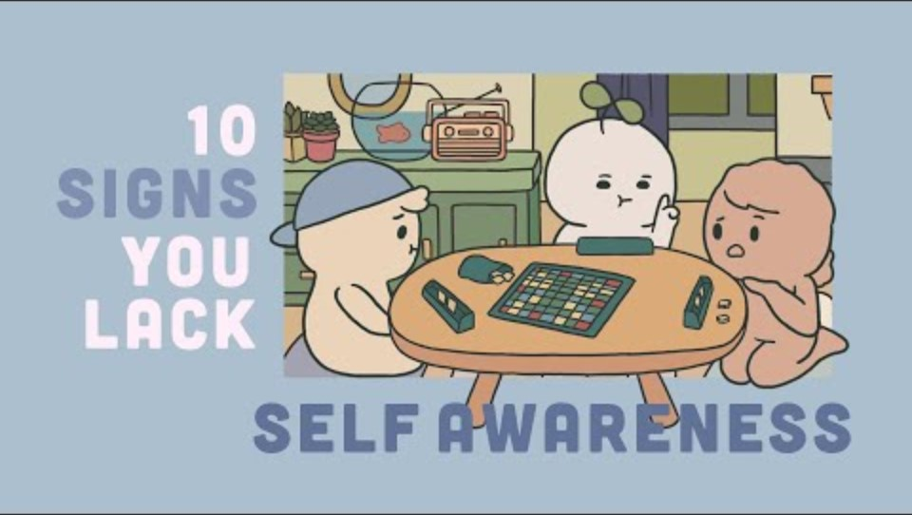
10 Signs You Might Be Lacking Self-Awareness

Slide 13
Group Discussion – Which of these may apply to you?
You Have Trouble Understanding Your Emotions
You Shut Others Down Who Feel Different Than You
You Make Excuses for Failures
It’s Difficult to Empathize With Others
You Can’t Explain Your Actions
You Suppress Your Emotions
It’s Hard To Make Realistic Goals
You Lack A Sense of Identity
You Can’t Stay on Track
You Struggle with Time Management

Slide 14

Self-Awareness: Internal and External
Internal self-awareness involves understanding your feelings, beliefs, and values — your inner narrative
External self-awareness involves understanding how our words and actions impact others

Slide 15

Internal or External
I always get super nervous and feel sick to my stomach before I get up to do a presentation.
Hard work is important to me, and I get frustrated seeing the developers playing ping-pong.
I sometimes cut people off if I think we are wasting time on a topic.
When I am bored in a meeting I tend to fidget and shake my legs.
I tend to let others talk in group settings because it’s hard to interrupt others.
I sometimes clench my teeth when I’m frustrated.
I really want to be a manager someday because I think I have what it takes.
I know what I want, and I have strong opinions on things, but that makes it hard for coworkers to disagree with me.

Slide 16
Why Self-Awareness Is Essential For Career Success
Contributes to empathy
We need to understand ourselves before we can understand others.
Improves communication skills
When you are aware of your communication style, it is easier to tailor it to specific audiences.
Assists with stress management
If you find yourself feeling irritable or burned out, you can take action to remedy the situation.
Leads to better time management
If you are most energized in the early morning, you can schedule analytical work for that time.
Facilitates decision making
Being mindful of potential biases and understanding how they can lead to poor choices, self-aware individuals make smarter decisions.
Increases self-control
Requires thinking about your reactions and acting in the most appropriate way possible
Boosts productivity
You can focus on your assets and delegate tasks that aren't within your area of expertise.

Slide 17
Improving Self-Awareness

Slide 18
William Sparks – Setting the Stage
William Sparks is a professor at the McColl School of Business at Queens University in Charlotte, NC
As a young man he started a doctoral program with a world-renowned professor named Jerry B. Harvey.
Sparks had recently gone through a divorce and he analyzed the toxic codependency in his divorce as the subject of his first paper.
Dr. Harvey called Sparks to his office to talk about his paper. He said he had “good news and bad news”.
The good news was he got an A on his paper. It was well researched and well written.

Slide 19
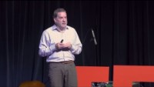
William Sparks – Self-Awareness

Slide 20
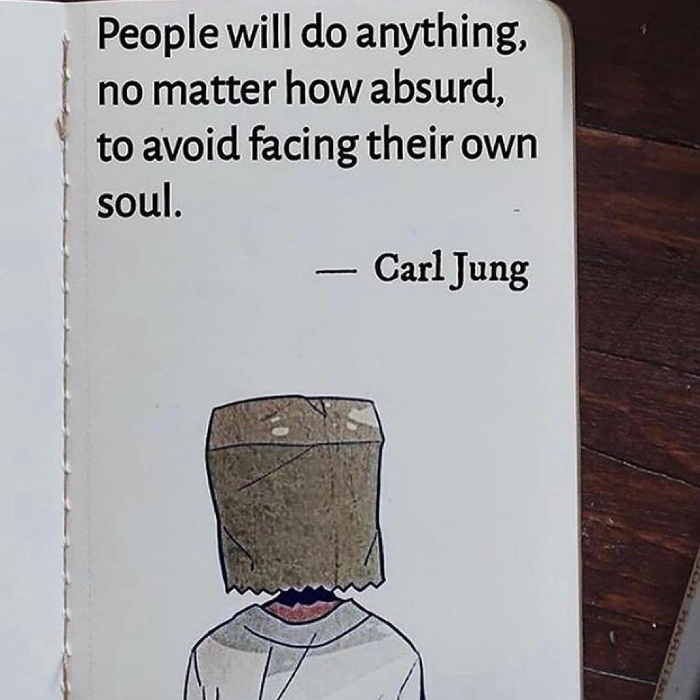
William Sparks Self-Awareness Group Discussion
What was the difference between the feedback given by Dr. Harvey vs. the friends at the bar?
Why is it important for us to own up to our own deficiencies and face them head on?
(Ether 12:27)
Why is it important for us to share constructive feedback with our peers instead of just “colluding with them”?

Slide 21

U02 Prepare: Teamwork Skills

Slide 22

Next Time
Self-Awareness continued
Phillip Walker Case Study

